Slide 1
Used Car Price Estimation Using Machine Learning
Team:
G. Praveen(160719733008)
Y. Karthikeya(160719733035)
D. Sai Dikshit(160719733047)
Project Coordinator:
T. Praveen Kumar
Under the guidance of:
Dr. D.Rajashekar

Slide 2
1.Introduction
◆ What metrics does a customer look for when buying a used car?
◆ When buying a used car, it’s difficult to predict the price because several metrics come into consideration, such as mileage, model, age, km driven, etc.
◆ Even it is difficult for a seller to value the actual price of the car based on its current
condition. Thus no one on both side knows the actual cost of it.
◆ By observing the issue, Machine learning algorithms can be used to predict the price of the car effectively and it can be an optimal solution for faster predictions.

Slide 3
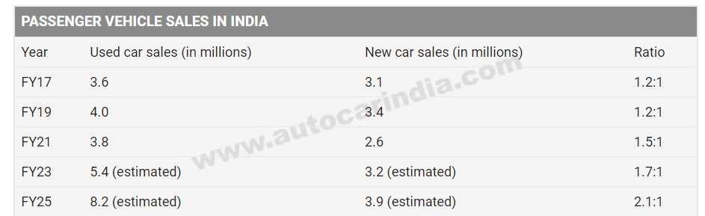

Slide 4
3.Motivation
To provide a platform where a customer can evaluate the genuine price of a used car based on its current features that the customer desires.
Through this, the customer cannot be misguided by mediators and
can pay the amount of the car with respect to its actual worth.

Slide 5
4.Gap Analysis
As most of the customers are unaware of the worth of a used car, they do not find a particular platform where their issues can be solved.
There exists some mediators, where even if the mediators know the actual cost, they hike the price to get a good share for themselves, which costs more for the customer.

Slide 6
5.Objectives to address gaps
By analyzing the gaps, the actual price of the used car can be predicted using machine learning models.
Through this, the conflict between customers and sellers are resolved and the mediators are removed in this process.
The results generated are time efficient and has better accuracy, which can save both time and money for the customer.

Slide 7
6.Problem Statement
Estimation of Used Car price using Machine Learning Algorithms.

Slide 8
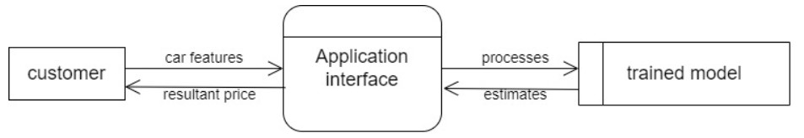
6.1 UML’S
DFD Level-0

Slide 9
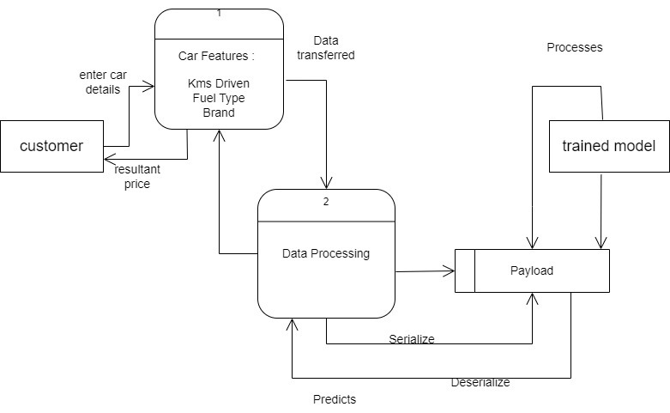
DFD Level-1:

Slide 10
Customer: The user who is using the Application
Application Interface: It’s the Software that the user interacts with.
Trained model: It’s a Stack developed using many machine learning
algorithms
Payload: Datastore
EDA: Finds the co-relation between the attributes and understands the certain characteristics of the attribute

Slide 11
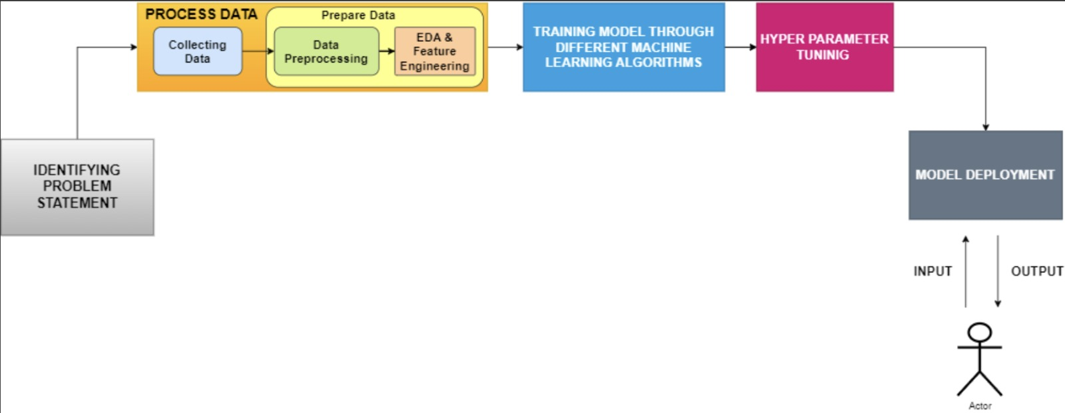
Architecture Diagram:

Slide 12
Describing Dataset Characteristics
Data Collection
The data was scraped from the website “cardekho.com”.
The python packages that included are Selenium and Pandas.
Selenium was used to automate the process of finding the car details dynamically from the infinity scroll process.
Then after storing all the details in the list of dictionaries, it was converted into csv file using pandas.

Slide 13
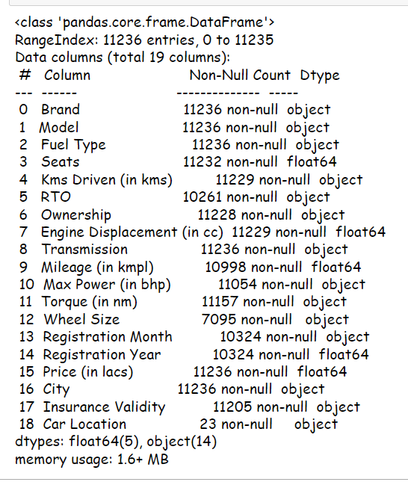
2. Data Preprocessing:
2.1 Observed Features

Slide 14
2.2 Observed Features
As it can be seen that most of the attributes consists of object types, thus converting them into int or float is a needed concern.
But firstly, replacing the NaN values with appropriate steps as follows
If the frequency is less, removing it using dropna() function.
Else handling them by mean/median/mode.
Thus, the objects are divided into 3 categories.
Numerical attributes (seats, kms driven, transmission, mileage etc)
Ordinal Categorical attributes (Ownership, Insurance Validity)
Nominal Categorical attributes (Brand, Fuel Type)
Thus, handling them using SimpleImputer, OrdinalEncoder and OneHotEncoder respectively.

Slide 15
2.3 Exploratory Data Analysis(EDA) and Data Visualisation
This is one of the important step to find the correlations between the attributes and understanding the certain characteristics of the attributes
Correlations can be found using various graphs present in seaborn library such as pairplot and heatmap.
The outliers can be rectified using boxplot and scatterplot.
2.4 Feature Standardisation
This process is used to standardise the car data in order to achieve Gaussian Distribution with mean = 0 and standard deviation = 1. Through this, it will be efficient for machine learning algorithms to run the data.
2.5 Feature Selection
After analysing the attribute relationships, removing the columns with high multicollinearity to reduce the dimensions.

Slide 16
3. Model Traning and Testing
After preparing the data completely, it is ready for the training of the model. Thus, before feeding the complete data to the model, splitting the data into train and test data frames. It can be achieved through train_test_split of the data with given percentage rate of the volume of train data. It will be beneficial during the testing process.
After splitting up the data, considering the train data only to run machine learning algorithms. As our problem statement is of regression, we have various machine learning regressors such as:
Multilinear regression
Ridge regression(L2 regularisation)
Lasso regression(L1 regularisation)
Decision Tree Regressor
There are also various Ensemble Learning Regressors such as RandomForestRegressor, XGBoostRegressor, AdaBoostRegressor, SVM(Support Vector Machine) etc. which is built under stacking, bagging and boosting models

Slide 17
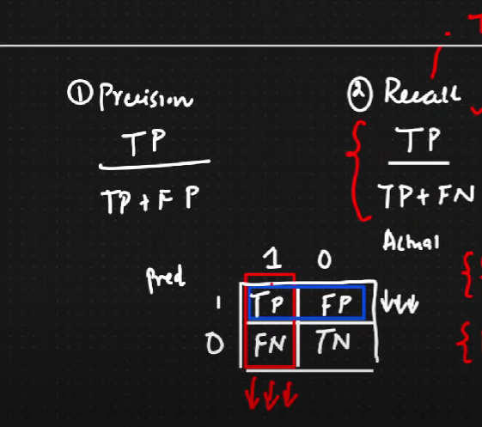
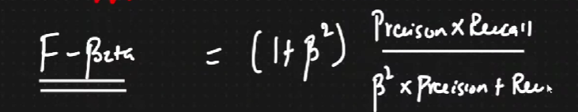
4. Hyperparameter Optimisation/Hyperparameter Tuning
This step is used to find the best parameters out of given parameters through RandomSerachCV, GridSearchCV and Bayesian Optimisation
5. Evaluation Parameters

Slide 18
7.Bibliography
http://ripublication.com/irph/ijict_spl/ijictv4n7spl_17.pdf
https://www.analyticsvidhya.com/blog/2021/07/car-price-prediction-machine-
learning-vs-deep-learning/
https://www.analyticsvidhya.com/blog/2021/07/car-price-prediction-machine-
learning-vs-deep-learning/
https://www.researchgate.net/profile/Mukkesh- Ganesh/publication/343878698_Used_Cars_Price_Prediction_using_Supervis ed_Learning_Techniques/links/5f461ab492851cd30230688b/Used-Cars- Price-Prediction-using-Supervised-Learning-Techniques.pdf

Slide 19
THANK YOU

